Slide 1
Introduction to Programming Principles
(with Python)
Sudharshan Welihinda(weli@iit.ac.lk)
Senior Lecturer, Department of Computing
Informatics Institute of Technology
Lecture 01

Slide 2

What is a Program?
An organized list (or group) of Instructions.
When they are grouped, these instructions perform a task.
Eg :
Event Agenda
Recipe
What is a Computer Program?
An organized list of Instructions that directs the computer to do a task you want and produce the result you want.
A computer program is like a recipe.
It contains a list of ingredients (called variables) and
List of instructions (called statements), that tell the computer what to do with the variables.
The variables can represent numeric data, text, or graphical images.

Slide 3
What Is Problem Solving ?
Problem solving is the process of a problem analysis and resolving it in the best way possible for that situation.
This process contains analyzing the problem (root cause analysis), defining countermeasures for the problem and implementing the right solution for that situation.
For problem solving, people need critical thinking and analytical skills.

Slide 4
Problem Solving cont…
Can you think of a day in your life which goes without problem solving?
Answer to this question is of course, No.
In our life we are bound to solve problems. Our day to day activity such as :
purchasing something from a general store and making payments,
depositing course fee in university, or
withdrawing money from bank account
All these activities involve some kind of problem solving.

Slide 5
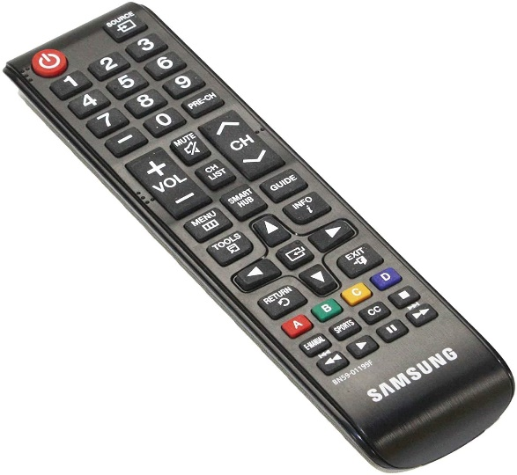
It can be said that whatever activity a human being or machine do for achieving a specified objective comes under problem solving.
To make it clearer, let us see some other examples.
Example 1:
If you are watching a news channel on your TV and you want to change it to a sports channel, you need to do something.
Move to that channel by pressing that channel number on your remote.
This is a kind of problem solving.

Slide 6
Problem Solving
Example 2:
One Monday morning, a student is ready to go to university but yet he/she has not picked up those books and copies which are required as per timetable.
So here picking up books and copies as per timetable is a kind of problem solving
Example 3:
If someone asks to you, what is time now?
So seeing time in your watch and telling him is also a kind of problem solving.

Slide 7
Problem Solving
Example 4:
Some students in a class plan to go on picnic and decide to share the expenses among them.
So calculating total expenses and the amount an individual have to give for picnic is also a kind of problem solving.
Now, broadly we can say that problem is a kind of barrier to achieve something and problem solving is a process to get that barrier removed by performing some sequence of activities
NOTE : it is necessary to mention that all the problems in the world can not be solved. There are some problems which have no solution and these problems are called Open Problems.

Slide 8
Algorithms
What is an Algorithm?
Algorithms are simply a series of instructions that are followed, step by step, to do something useful or solve a problem
Basic structure of an Algorithm
  Sequence - An algorithm is executed step by step, sequentially
  Statement 1 or Instruction 1
  Statement 2 or Instruction 2
  ……………..
  Statement 10 or Instruction 10
  Selection / Branching
  Repetition / Iteration / Looping

Slide 9
Algorithm Example – How to make a phone call
0. Start
1. Pick up the phone.
2. Open your phone's Phone app
3. Search for friend’s phone number in the contact list
4. Select the number and dial it by clicking on the dial button.
5. Wait for the network to connect.
6. If connection is successful, you will hear the dialer tone, when you are done with the call, tap End Call. Go to step 8
7. if network connection failure, number will not be dialed. Go to step 8
8. Stop

Slide 10
Algorithms - Example
Algorithm to withdraw cash from ATM
1. Start.
2. Go to the ATM
3. Insert your card into the machine
4. Press in your code
5. Choose “Withdraw” and enter Amount required
6. Take the cash, slip and card.
7. Stop.

Slide 11
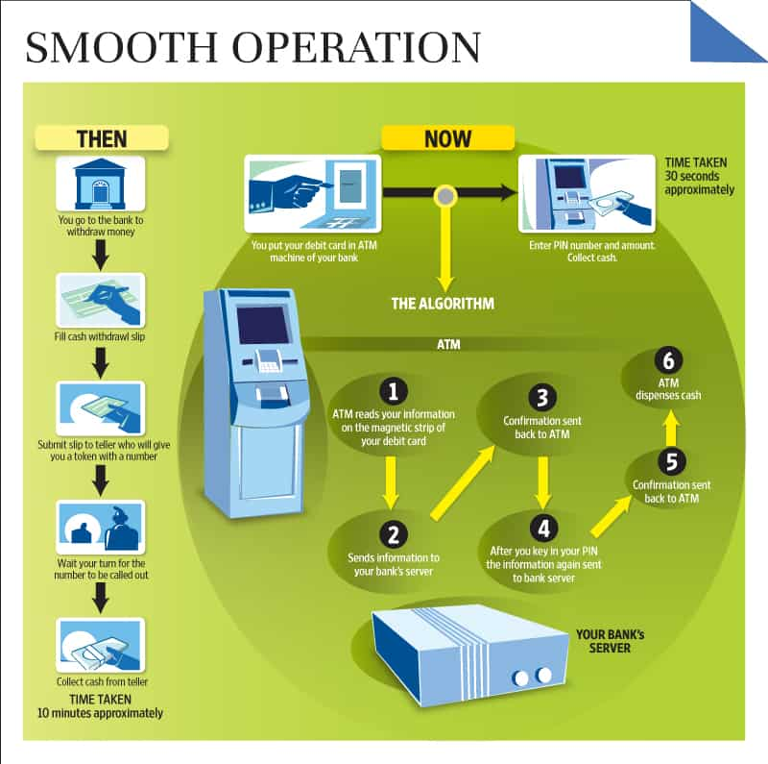

Slide 12
Algorithm Example– How to brush your teeth
0. Start.
1. Pick up your tooth brush & toothpaste.
2. Remove the lid from the tube of toothpaste.
3. Hold your toothbrush in one hand, and the toothpaste in your other hand.
4. Squeeze the tube of toothpaste gently.
5. Put toothpaste on the toothbrush.
5.1 Close the toothpaste lid.
6. Brush your teeth at the top.
5.2 Put down the toothpaste.
7. Brush your teeth at the bottom.
8. Repeat step 6 & step 7 until they are clean.
9. Wash your mouth & the toothbrush.
10. Put the toothbrush away.
11. Stop.

Slide 13
Pick up the toothpaste in one hand
Open the lid of the toothpaste
Pick up the toothbrush in your other hand
Hold the toothbrush so that the bristles are under the open end of the toothpaste
Gently squeeze a small amount of toothpaste onto the toothbrush bristles
Close the toothpaste lid
Put down the toothpaste
Turn on the tap with your free hand
Hold the toothbrush so that the bristles are under the running water for 2 seconds
Turn off the tap with your free hand
Hold the toothbrush so that the bristles are pressing against your teeth
Move the toothbrush in small circles so that the bristles move against your teeth and gums
Spit out the toothpaste
Turn on the tap with your free hand
Rise the toothbrush under the running water
Wash out your mouth with water
Turn off the tap
Put down the toothbrush

Slide 14
Algorithms
List down the steps required in the following scenarios and prioritize them
  Prepare a cup of tea (1) -
Prepare a cup of tea (2) – Sugar Optional
  Prepare an omelet for the dinner(1)
Prepare an omelet for dinner (2) – Only with good eggs

Slide 15
1. Set out the kettle, cup, sugar,
milk, tea etc.
2. Put water into kettle.
3. Plug in Kettle.
4. Wait for kettle to boil.
5. Put tea bag in cup.
6. Add water to cup.
7. Remove tea bag with spoon / fork.
8. Add milk.
9. Add sugar.
10. Serve.
11. Stop.

Slide 16
Algorithms
An algorithm means that the following properties are all true:
An algorithm is an unambiguous description that makes clear what has to be implemented. e.g. “Bake until done” , “Choose a large number”
An algorithm expects a defined set of inputs.
An algorithm produces a defined set of outputs.
An algorithm is guaranteed to terminate and produce a result, always stopping after a finite time.

Slide 17
Algorithms
Question
In a cycle race, the participating cyclists are required to qualify from the preliminary stage into the final stage, by passing a medical test and then by completing ten rounds in a circular track.
Those who do not pass the medical test will not be allowed to attempt ten rounds in the track.
Those who complete ten rounds in the track are eligible to participate in the final stage. Others who get tired and are unable to complete ten rounds in the track are eliminated from the contest.
Write a suitable algorithm and a python program to the above scenario

Slide 18
Algorithms
Answer
Start
Initialize variables.
Get/Ask for Medical test results. If Medical test result is negative display an error message and go to step 6.
Get/Ask for number of laps. If number of laps value is less than ten display an error message and go to step 6.
Display “You’re eligible for the race. Congratulations!”
Display “You’re not eligible for the race.”
Stop.

Slide 19
Algorithm – To prepare a Cup of Tea
Wait for kettle to boil.
1. Set out the kettle, cup, sugar,
milk, tea etc.
2. Add milk.
3. Remove tea bag with spoon/fork.
2. Put water into kettle.
4. Set out the kettle, cup, sugar, milk,
tea etc.
3. Plug in Kettle.
4. Wait for kettle to boil.
5. Plug in Kettle.
5. Put tea bag in cup.
6. Serve.
6. Add water to cup.
7. Put water into kettle.
7. Remove tea bag with spoon / fork.
8. Add water to cup.
8. Add milk.
9. Add sugar.
9. Add sugar.
10 Put tea bag in cup.
11. Stop.
10. Serve.
11. Stop.
Back

Slide 20
Algorithm – To prepare a Cup of Tea
Set out the kettle, cup, sugar, milk, tea etc.
2. Put water into kettle.
3. Plug in Kettle.
4. Wait for kettle to boil.
5. Put tea bag in cup.
6. Add water to cup.
7. Remove tea bag with spoon / fork.
8. Add milk.
9. If (Sugar is needed) then add sugar
else do nothing
10. Serve.
11. Stop.
Back

Slide 21
Algorithm – To prepare an Omelette
1. Set out the cookware (small & larger bowl), the recipe, Four eggs,
and the fresh spices
2. Crack an egg into a small bowl.
3. Scramble the egg, and then pour it into the larger bowl.
4. Repeat step 2 through step 3 four times.
5. Add the filling, the seasonings and the spices.
6. Cook the omelet to perfection.
7. Stop.
Back

Slide 22
Algorithm – To prepare an Omelette
1. Set out the cookware (small & larger bowl), the recipe, a dozen eggs,
and the fresh spices
2. Crack an egg into a small bowl.
3. If the egg is bad then
discard the foul egg and wash the small bowl.
else
Scramble the egg, and then pour it into the larger bowl
4. Repeat step 2 through step 3 eleven times.
5. Add the filling, the seasonings and the spices.
6. Cook the omelet to perfection.
7. Stop.
Back

